Slide 1

Exploratory Data Analysis of US American Airlines Financial Performance
A comprehensive analysis of financial trends from 2000 to 2019

Slide 2
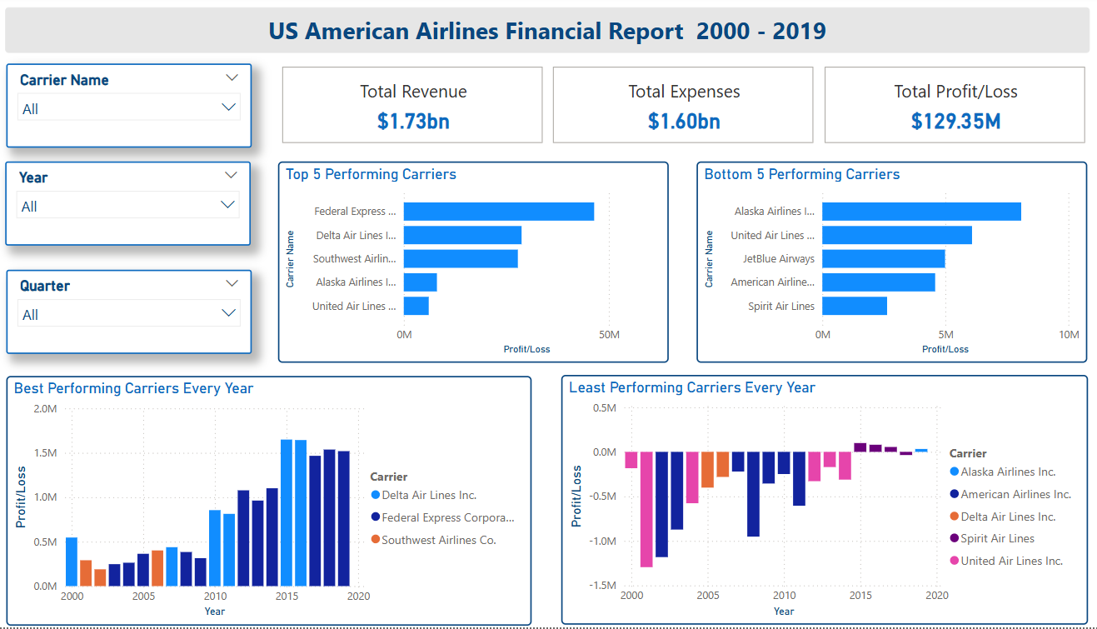
US American Airlines Financial Summary (2000 - 2019)
Exploring Revenue, Expenses, and Profit Trends Over a two decades

Slide 3
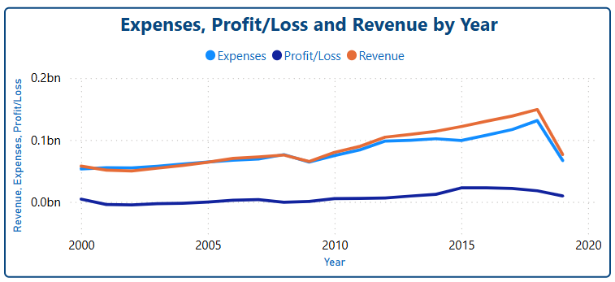
US American Airlines Financial Overview (2000 - 2019)
Exploring Revenue, Expenses, and Profit Trends Over a two decades
Revenue (Orange Line): Starts at around 0.1B in 2000 and remains relatively flat until around 2010.
Post-2010, revenue shows a steady increase, peaking at approximately 0.2B around 2018 and sharp decline post 2018 due to no data for 2019 Q3 and Q4.
Expenses (Blue Line): Begins slightly below 0.1B in 2000, closely tracking revenue until 2010.
From 2010 to 2018, expenses rise in tandem with revenue, peaking near 0.2B in 2018.
Profit/Loss (Black Line): Remains close to 0 throughout the period, fluctuating slightly between small profits and losses.
Notable drop below 0 (losses) occur around 2001–2003, 2008–2009, while small profits are seen in 2015–2018.

Slide 4
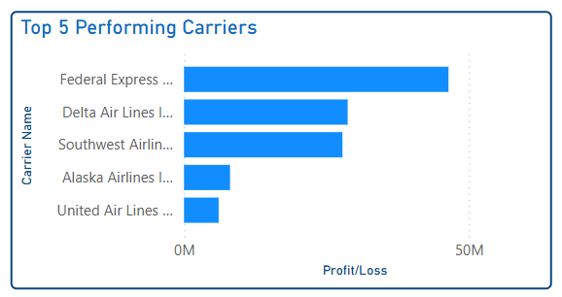
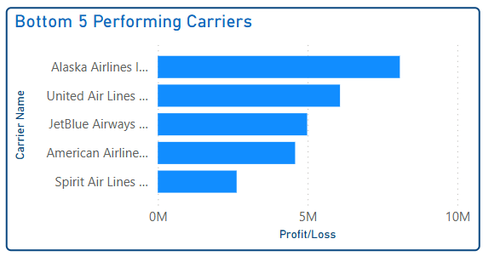
Top vs. Bottom Airlines Profitability
Comparison of profitable and unprofitable airlines' financial performance
Cargo vs. Passenger Carriers: Federal Express leads due to its cargo business model, which has been a stable revenue source ($2.3B overall revenue in 2018 with $58M profit margin), unlike passenger carriers affected by demand fluctuations.

Slide 5
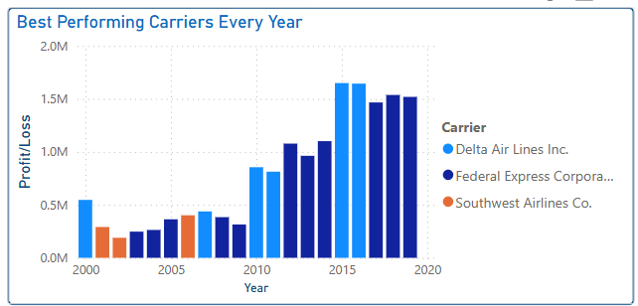
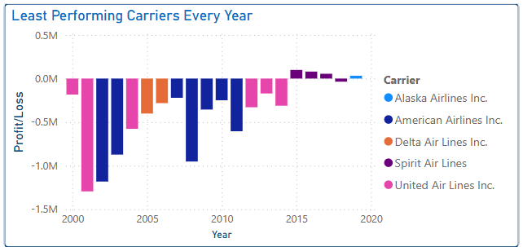
Best and Least Performing Carrier Every Year
Comparison of Best and Least airlines' financial performance based on the Profit/Loss

Slide 6
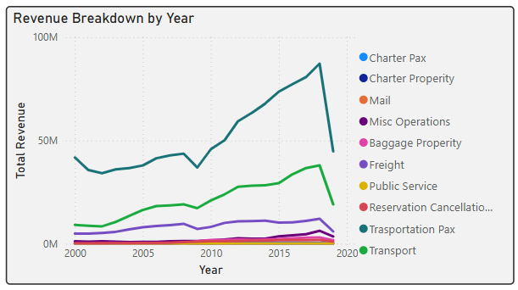
Revenue Composition Over Time
Breakdown of Revenue Sources
Total Revenue Growth: Except Passenger revenue most revenue starts low (below 10M) from 2000 to around 2005. A significant increase begins around 2009/10, then sharply declining by 2018.
Passenger Revenue (Dark Green) is the largest contributor, peaking at around 40M in 2015–2018.
Transport Revenue (Light Green) follows, reaching 20–25M during the same peak period.
Baggage Revenue, Cargo Revenue, Charter Revenue, and Miscellaneous Revenue are smaller, typically below 10M, but show growth over time.

Slide 7
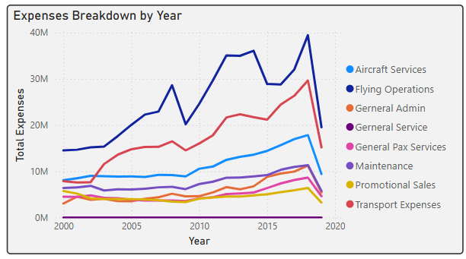
Expenses Composition Over Time
Breakdown of Expenses Sources
A significant increase in airline expenses from 2000 to 2018, driven by Flying Operations and Aircraft Services, peaking at 40M, followed by a decline from 2018
Major Cost Drivers: Flying Operations and Aircraft Services dominate, consistent with the EDA’s high operating costs.
Minor Categories: Expense on promotional sales and passenger general services remain low, aligning with the EDA’s observation of minimal

Slide 8
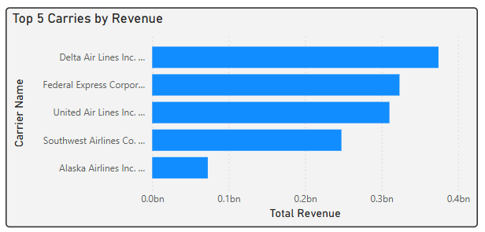
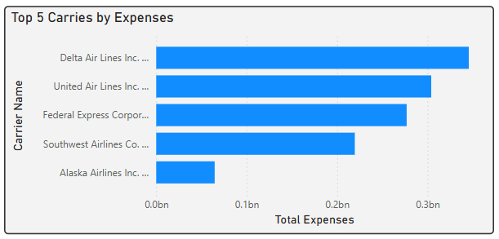
Top 5 Carriers by Revenue and Expenses
Delta Air Lines Inc. tops with highest revenue, slightly above 0.4bn, reflecting its position as a major legacy carrier with significant passenger and ancillary revenue streams, followed by Federal Express Corporation and United Airlines Inc.
Delta Air Lines Inc. incurs highest expenses, slightly above 0.3bn, indicating significant operational costs followed by United Airlines Inc.
Southwest’s lower expenses highlight its cost-efficient model, and steady profits, a hallmark of low-cost carriers.
Delta’s revenue (0.4bn) exceeds its expenses (0.3bn), suggesting a profit margin, consistent profit margin from 2010 – 2018 and highest profits in 2015.
United’s revenue (0.3bn) matches its expenses (0.3bn), indicating minimal profit, aligning with its historical volatility

Slide 9
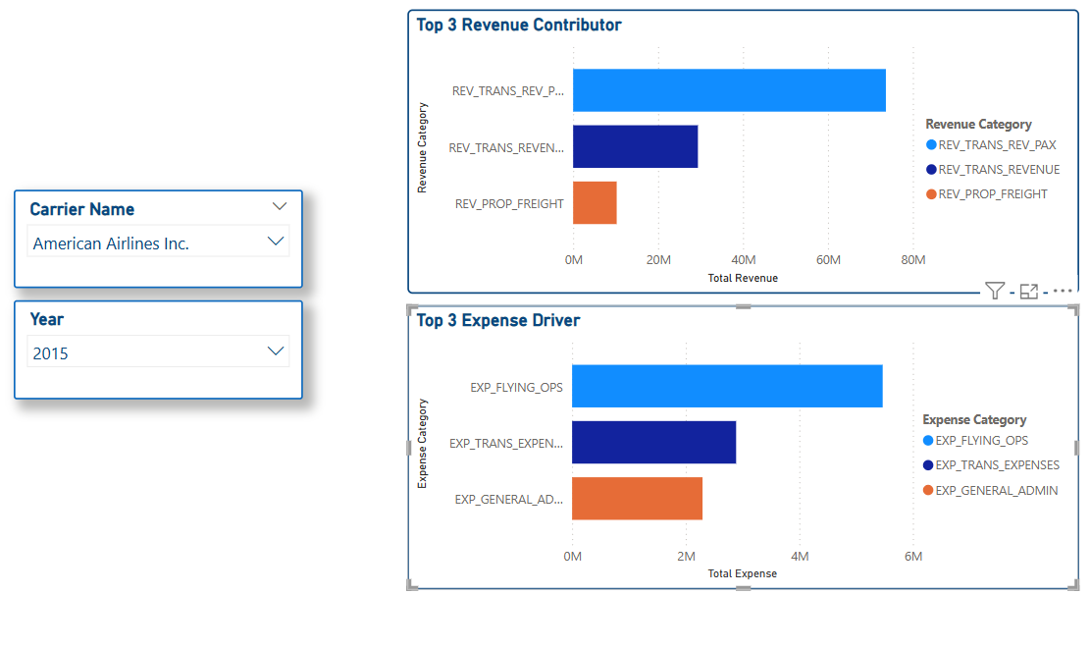
Breakdown Summary by Carrier and Year

Slide 10
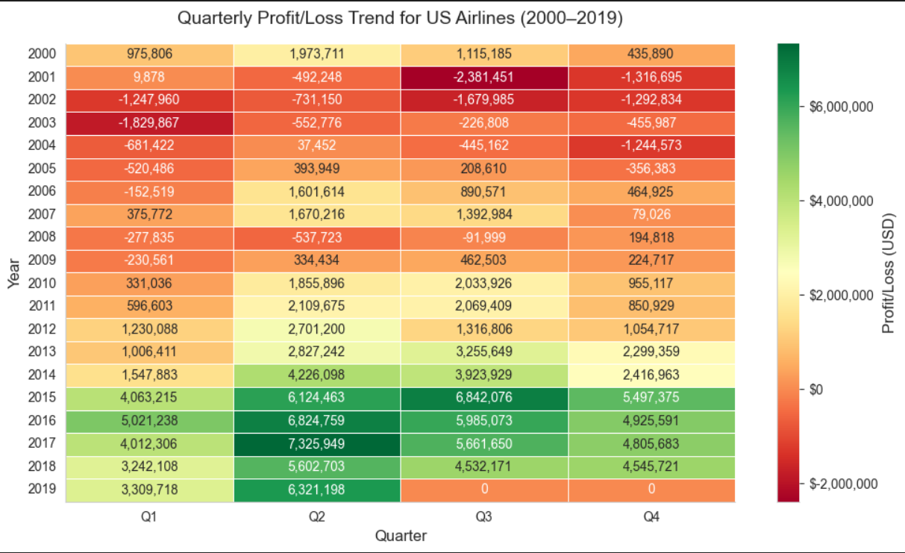
Quarterly Profit/Loss Trend Analysis

Slide 11
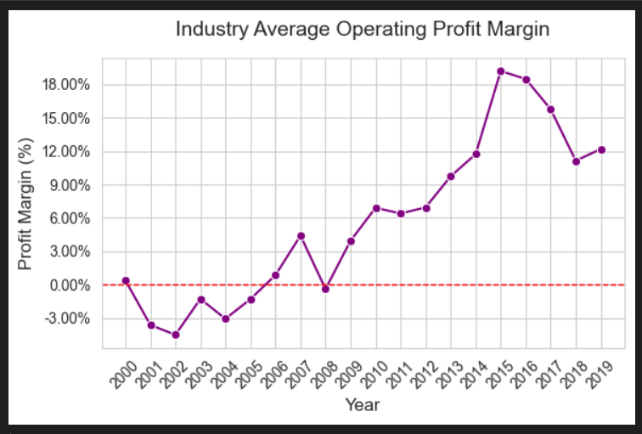
Profit Margin Analysis
The profit margin showed a steady increase, peaking at around 18% in 2015. This suggests a period of strong industry performance, possibly due to cost efficiencies or increased demand or operational strategies.
The upward trend was consistent, with notable growth from 2006 (around 0%) to 2010 (around 6%), and continued acceleration through 2015.
After reaching its peak in 2015, the profit margin declined sharply to around 9% by 2016, then stabilized with slight fluctuations, ending at approximately 12% in 2019.

Slide 12
Key Highlights
Revenue Growth: Delta’s leading revenue aligns with the EDA’s finding of significant revenue growth (e.g., from $2.15B in Q4 2001 to $7.87B in Q4 2018), driven by consolidation and ancillary revenues like baggage fees.
Cargo Strength: Federal Express’s ranking matches the EDA’s observation of high freight revenue, a stable source compared to passenger revenue volatility.
Low-Cost Performance: Southwest’s revenue reflects its steady growth (e.g., $1.01B profit in Q4 2015), supporting the EDA’s insight into low-cost carriers’ profitability.
Profit Margin: The gap between revenue and expenses is narrow throughout, indicating tight margins, a common trait in the airline industry. Profits are minimal even during growth years (2015–2018), suggesting high operating costs (e.g., flying operations, as noted in the EDA) offset revenue gains.
Possible External Impacts: Losses are most pronounced during major disruptions (2001, 2008), aligning with the findings of could be the external impacts like 9/11, the financial crisis

Slide 13
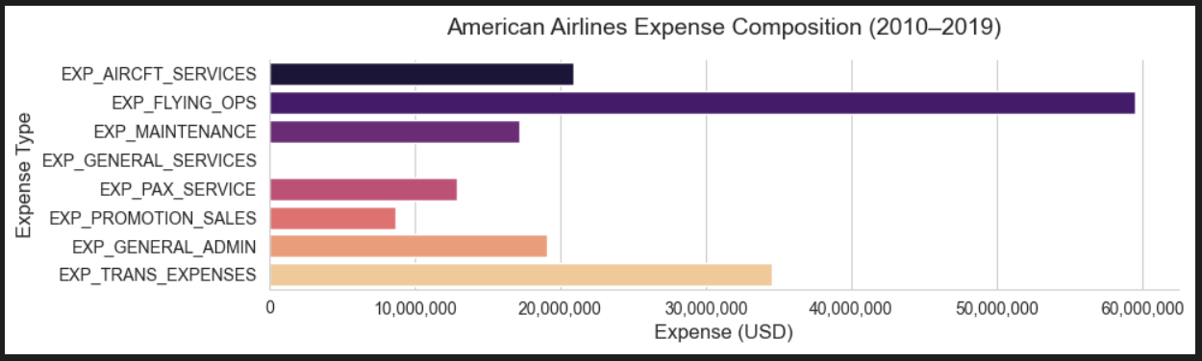
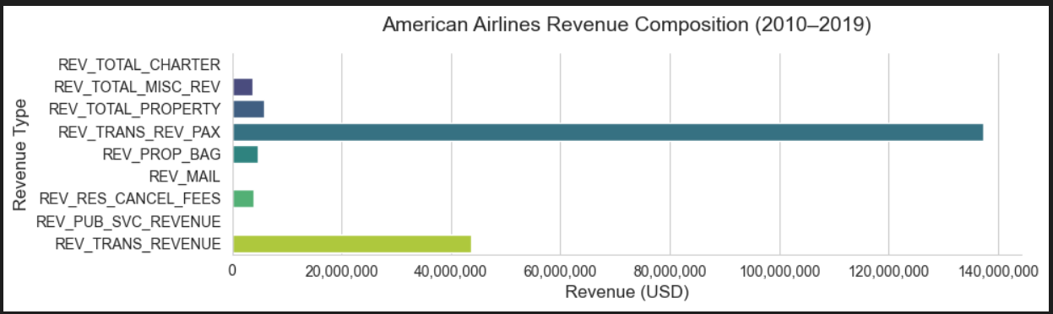
Brief Overview of Scenario 2
Carrier: American Airlines Inc.
Expense breakdown shows transportation and flying operations as the largest cost drivers.
Revenue composition is higher from the passenger revenue, but ancillary revenues (baggage fees, reservation change fees, etc.) also contribute significantly.

Slide 14
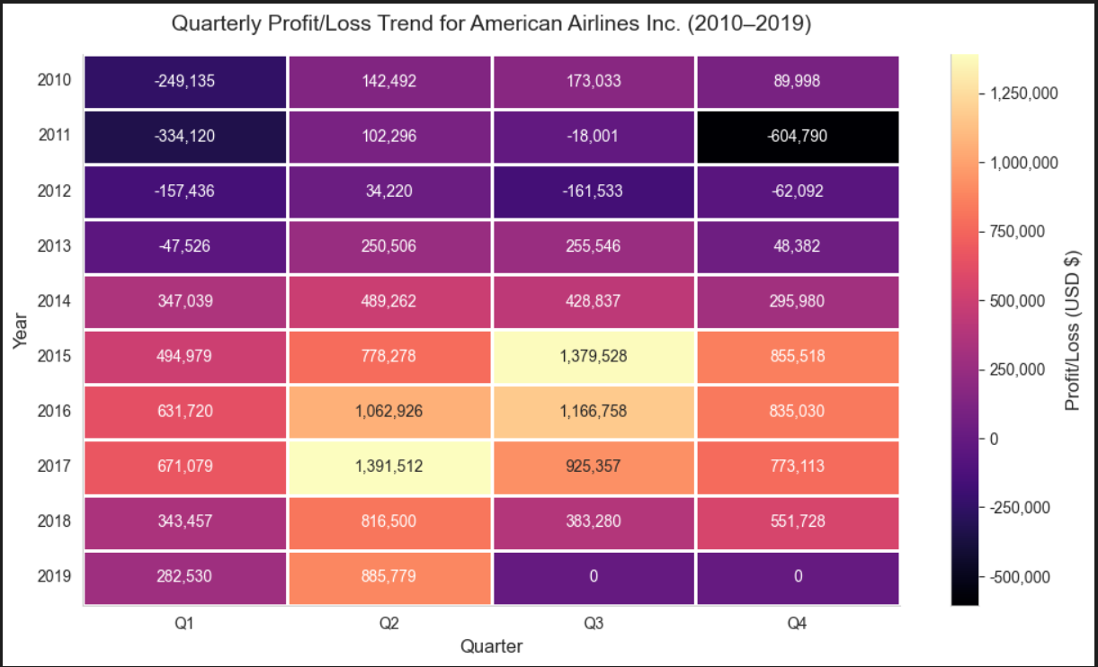
Brief Overview of Scenario 2
Carrier: American Airlines Inc.
American Airlines Inc. saw revenue and profit growth post-2013, with improved profit margins in most years.
The airline experienced negative profit/loss in 2011 and 2012 years.
Quarterly analysis reveals seasonal patterns, with Q2 and Q3 generally showing higher revenues and profits, likely due to increased travel demand in summer months.

Slide 15
Brief Overview of Scenario 2
Carrier: American Airlines Inc.
The 1.43% profit margin for American Airlines Inc. is significantly lower than the industry average, which ranged from -3% to 18% over the same period. This shows American Airlines Inc. underperformed relative to the industry even during the peak years.
The modest profit suggests that while the company benefited from the industry’s growth post 2013.

Slide 16
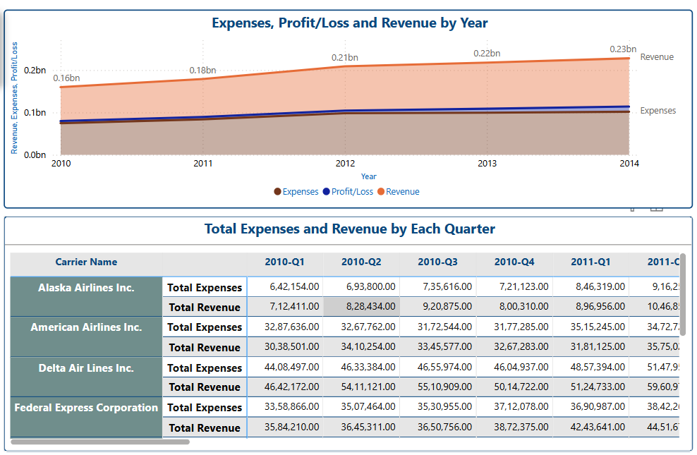
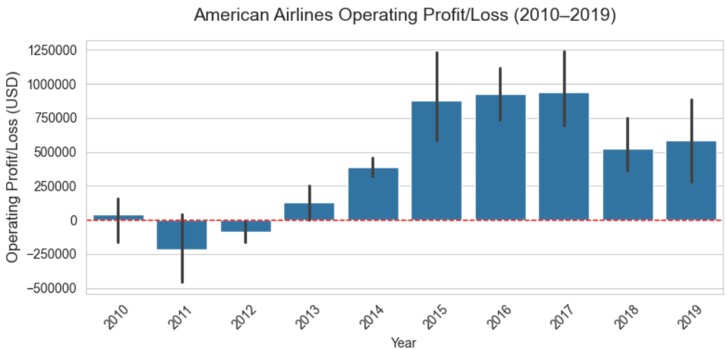
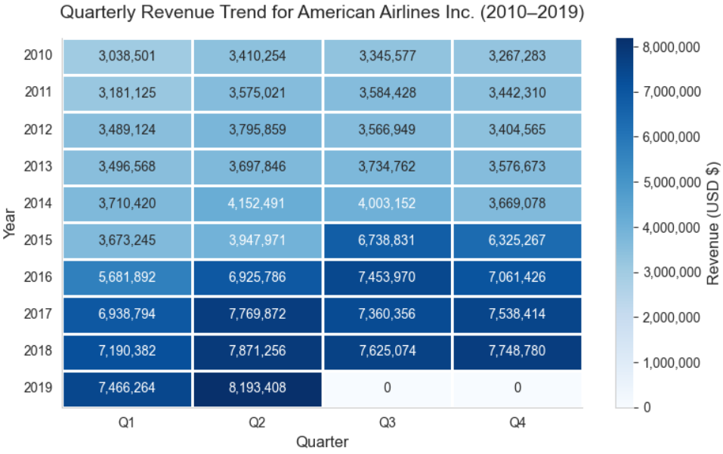
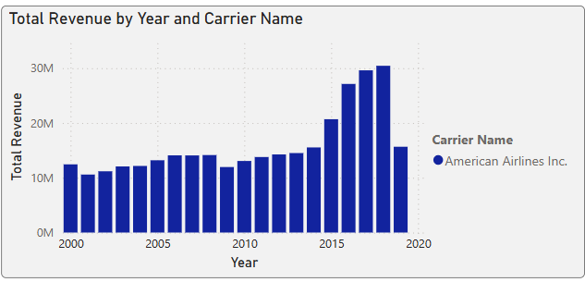
Additional Reports

Slide 17
Technical Evaluation of Data
Assessing the quality, reliability, and suitability of data
Dataset
This raw dataset (‘airlines_financials_2010_2019.csv’) contains quarterly financial information from the largest US American Airlines from 2000 - 2019.
Setup for Analysis
MS SQL Server, Power BI Desktop, VSCode, Python

Slide 18
Data Architecture Layers in MS SQL Server
Understanding Data Processing and ETL Process
Bronze Layer: Raw Data
This layer consists of raw CSV data provided imported directly using SSMS 'flat file import wizard' into Bronze Layer without any modifications or processing. It serves as the foundational dataset for further transformation.
Silver Layer: Cleaned Data
Data Architecture Layers
In the Silver Layer, data is cleaned and transformed to ensure accuracy and consistency, making it ready for analysis and reporting processes.
Gold Layer: Aggregated Data
The Gold Layer features aggregated data that is organized and summarized for effective reporting and in-depth analysis, providing insights for decision-making.

Slide 19
Data Dictionary
Column Name | Description
UNIQUE_CARRIER_NAME | Full name of the airline carrier
YEAR | Year of the financial record
QUARTER | Financial quarter (1–4)
Overall_OP_EXPENSES | Total operating expenses
Overall_OP_PROFIT_LOSS | Operating profit or loss (Revenue - Expenses)
Overall_OP_REVENUES | Total operating revenue
Rev_CHARTER_PAX | Revenue from charter passenger services
Rev_CHARTER_PROP | Revenue from chartered property/freight
Rev_MAIL | Revenue from transporting mail
Rev_MISC_OP_REV | Miscellaneous operating revenue
Rev_PROP_BAG | Baggage fee revenue (e.g., checked bags)
Rev_PROP_FREIGHT | Revenue from freight transportation
Rev_PUB_SVC_REVENUE | Public service revenue (e.g., subsidies)
Rev_RES_CANCEL_FEES | Revenue from reservation change or cancellation fees
Rev_TOTAL_CHARTER | Total charter revenue (passenger + property)
Rev_TOTAL_MISC_REV | Combined miscellaneous revenues
Rev_TOTAL_PROPERTY | Combined property-related revenue (freight, baggage)
Rev_TRANS_REVENUE | Transport Related Revenues
Rev_TRANS_REV_PAX | Revenue from passenger ticket sales
Exp_AIRCFT_SERVICES | Aircraft servicing expenses (fuelling, cleaning, etc.)
Exp_FLYING_OPS | Flying operations costs (pilots, staff, dispatch, fuel)
Exp_GENERAL_ADMIN | Corporate admin costs (Operational staff, IT, HR)
Exp_GENERAL_SERVICES | General services expenses (support, station ops)
Exp_MAINTENANCE | Maintenance and repair costs
Exp_PAX_SERVICE | Passenger services (catering, entertainment, in-flight cost)
Exp_PROMOTION_SALES | Marketing, promotions, and sales expenses
Exp_TRANS_EXPENSES | Expenses tied to transporting passengers and goods

Slide 20
Data Cleaning Techniques
Identify null values
Assess the dataset for any null values that may skew the analysis results, ensuring a complete dataset is used for financial assessments.
Replaced all non-numeric values with 0 as most of the columns are financial related columns with numeric values.
Detect non-numeric values
Locate and handle any non-numeric values in numeric fields to maintain data accuracy and reliability for financial calculations.
Ensuring that the data remains consistent and accurate, which is essential for valid analysis of American Airlines financials.
Implement default replacements
Replace identified null and non-numeric values with appropriate default values to prevent analysis errors and maintain data consistency.

Slide 21
Data Cleaning Techniques
Identify Data in the Columns
Upon examining the data closely, it became evident that there were issues related to the calculation of specific revenue elements and the management of missing or zeroed total values within the financial information.
These revenue components can be calculated from other columns with approximate values due to incomplete data
Rev_TOTAL_CHARTER = Rev_CHARTER_PAX + Rev_CHARTER_PROP
Rev_TOTAL_MISC_REV = Rev_MISC_OP_REV
Rev_TOTAL_PROPERTY = Rev_PROP_BAG + Rev_PROP_FREIGHT
Other Assumption:
Ancillary Revenue = [Baggage Revenue] + [Reservation Fee Revenue] + [Misc Revenue]
+ [Freight Revenue] + [Mail Revenue]

Slide 22
Effective Duplicate Record Management
Higher Revenue Retention
Retaining records with the highest revenues enhances the quality of financial assessments.
Profit and Loss Focus
Prioritizing records based on profit/loss ensures accurate evaluation of financial health.
Effective deduplication leads to more accurate financial reporting, benefits the stakeholders.
Enhanced data accuracy supports better decision-making processes.
Every duplicate record for a particular airline in a particular year and quarter have different values for the financial columns.
To proceed further, need remove the duplicate records
and keeping the highest Overall_OP_REVENUES and Overall_OP_PROFIT_LOSS value
for each airline in a specific year and quarter.
In real-world scenarios, we consult the business stakeholders to decide on the best approach for handling duplicates.

Slide 23
Aggregated Tables
CarrierProfitSummary
This table summarizes the minimum and maximum profit/loss per year, along with the corresponding carriers.
CarrierExpenseDetails
This table unpivots the expense-related columns (Exp_AIRCFT_SERVICES, Exp_FLYING_OPS, etc.) into a single Expense_Value and Expense_Category pair.
CarrierRevenueDetails
This table unpivots the revenue-related columns (Rev_CHARTER_PAX, Rev_CHARTER_PROP, etc.) into a single Revenue_Value and Revenue_Category pair.
As SQL Server can handle large datasets more efficiently for transformations like unpivoting, especially on a database level, compared to Power BI, which is more suited for visualization and lighter transformations.
Power BI used for visualization for recreating the charts in the report by connecting to these SQL tables.

Slide 24
Transformed Dataset Overview
Loaded the cleaned data and transformed data into the Gold Layer Table for Exploratory Data Analysis and Reporting
624 Entries:
The dataset encompasses a total of 624 entries, providing a comprehensive view of operational performance.
3 key metrics:
Key financial focus metrics include Overall OP Expenses, Overall OP Profit/Loss, and Overall OP Revenues.
27 columns:
This dataset consists of 27 columns detailing various financial metrics and operational indicators.
100% non-null:
All columns in the dataset have a 100% non-null count, ensuring data integrity for analysis.

